Slide 1
Hacking Through History:
The Enigma
Noemi Glaeser
USC Cybersec
26 October 2018
Notes:
Paper enigma: https://www.themarysue.com/papercraft-engima/
http://wiki.franklinheath.co.uk/index.php/Enigma/Paper_Enigma#Acknowledgements
https://fhcouk.files.wordpress.com/2012/05/pringlesenigma3a4.pdf
Online Simulator: http://enigmaco.de/enigma/enigma.html
Enigma Replica: http://www.instructables.com/id/Make-your-own-Enigma-Replica/

Slide 2
The Inventor(s)
At the end of World War I: cryptanalysts are winning the battle against cryptographers
The Zimmermann Telegram, the ADFGVX cipher
In 1918, Arthur Scherbius and Richard Ritter founded Scherbius & Ritter
Scherbius studied electrical engineering in Hanover and Munich
Wanted to replace paper-and-pencil cryptography with 20th-century technology
First patent in 1918
Concurrent inventions:
1919: Hugo Alexander Koch, Netherlands
1919: Arvid Damm, Sweden
1921: Edward Hebern, United States

Slide 3
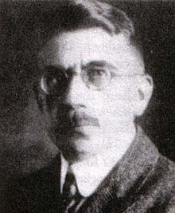
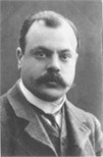
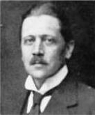
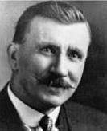
The Inventor(s)
Arthur Scherbius
Hugo Alexander Koch
Arvid Damm
Edward Hebern
Notes:
Sources:
Scherbius: https://upload.wikimedia.org/wikipedia/commons/thumb/3/36/Arthur_Scherbius_1.jpg/220px-Arthur_Scherbius_1.jpg
Koch: http://ciphermachines.com/pictures/types/koch.jpg
Damm: http://ciphermachines.com/pictures/types/damm.jpg
Hebern: http://images.computerhistory.org/blog-media/hebern-rotor-machine-Edward-Hebern.jpg?w=133&h=164

Slide 4
The Design
Keyboard
Scrambler
3 scramblers/“rotors”
Display lampboard
Reflector
Plugboard
6 cables to swap 6 pairs of letters

Slide 5
Crash Course: Polyalphabetic ciphers
a b c d e f g h i j k l m n o p q r s t u v w x y z | K LM N O P Q R S T U V W X Y Z A B C D E F G H I J
a b c d e f g h i j k l m n o p q r s t u v w x y z | E F G H I J K LM N O P Q R S T U V W X Y Z A B C D
a b c d e f g h i j k l m n o p q r s t u v w x y z | Y Z A B C D E F G H I J K LM N O P Q R S T U V W X
thisencryptionispolyalphabetic
+KEYKEYKEYKEYKEYKEYKEYKEYKEYKEY
-------------------------------
=DLGCILMVWZXGYRGCTMVCYVTFKFCDMA

Slide 6
Crash Course: Polyalphabetic ciphers
a b c d e f g h i j k l m n o p q r s t u v w x y z | K LM N O P Q R S T U V W X Y Z A B C D E F G H I J
a b c d e f g h i j k l m n o p q r s t u v w x y z | E F G H I J K LM N O P Q R S T U V W X Y Z A B C D
a b c d e f g h i j k l m n o p q r s t u v w x y z | Y Z A B C D E F G H I J K LM N O P Q R S T U V W X
thisencryptionispolyalphabetic
+KEYKEYKEYKEYKEYKEYKEYKEYKEYKEY
-------------------------------
=DLGCILMVWZXGYRGCTMVCYVTFKFCDMA
Repetition leads to patterns, which makes encryption weak

Slide 7
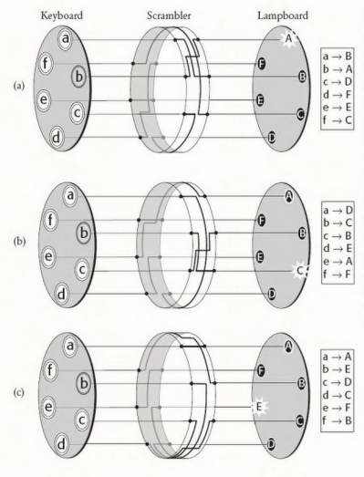
Design: The Scrambler
Rubber disk with internal wirings
Simplified example with a 6-letter alphabet
Scrambler revolves by ⅙ after each letter is encoded
Polyalphabetic cipher with key length 6

Slide 8
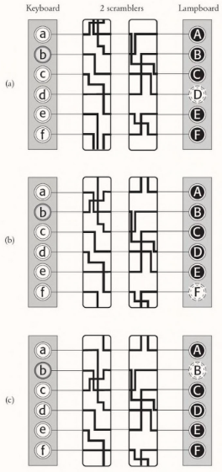
Design: The Scrambler
Rubber disk with internal wirings
Simplified example with a 6-letter alphabet
Scrambler revolves by ⅙ after each letter is encoded
How about two scramblers?

Slide 9
Design: The Scrambler
Rubber disk with internal wirings
Simplified example with a 6-letter alphabet
Scrambler revolves by ⅙ after each letter is encoded
How about two scramblers?
Scrambler #1 (left) always advances
Scrambler #2 only advances when #1 completes a revolution
Polyalphabetic cipher with key length 6² = 36

Slide 10
Design: The Scrambler
Rubber disk with internal wirings
Simplified example with a 6-letter alphabet
Scrambler revolves by ⅙ after each letter is encoded
Scherbius’ design actually used 3 scramblers
26³ = 17,576 arrangements
Removable and interchangeable scramblers
Notes:
Initial arrangements

Slide 11
Design: The Reflector
Also a rubber disk with internal wirings
Static, so it doesn’t add to the number of cipher alphabets
But it’s beneficial because it simplifies decryption: due to the reflector, encryption and decryption are mirror processes (symmetric)

Slide 12
Design: The Plugboard &
The Ring
Between the keyboard and the first scrambler
Swap six pairs of letters before they enter the scramblers
Moves the wiring in the scramblers in relation to the letters

Slide 13
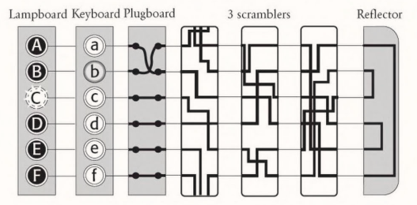
The Final Design
Notes:
Simulator: http://enigmaco.de/enigma/enigma.html

Slide 14
In practice
Rotate scramblers to correct starting position
26³ = 17,576 possibilities
The initial position can be considered the “key”
Codebook lists key for each day
Note: the rotor rotates before encrypting the first letter
Type in your plaintext to encrypt
Type in your ciphertext to decrypt

Slide 15
The Complexity
Scrambler orientations
Ring orientations
Scrambler arrangements
Plugboard
Total
= 26³ = 17,576
= 26³ = 17,576
= 3! = 6
= 26!/(14!6!2⁶) = 100,391,791,500
≈ 100,000,000,000,000,000,000 = 10²⁰
Notes:
Plugboard complexity explanation: https://math.stackexchange.com/questions/1095042/number-of-possible-combinations-of-the-enigma-machine-plugboard

Slide 16
Fun activity time yay

Slide 17
Assembly tips
I found it best to wrap the slips around the can and THEN tape the ends together
Make sure the strips are tight, but can still be rotated smoothly
Put tape either on the back side or across the entire edge on the front (it will make things easier later)

Slide 18
Level 0: Basic Configuration
Reflector B, Rotor I, Rotor II, Rotor III, Input/Output
Line up the grey bars on the leftmost (reflector) and rightmost (input/output) strips
Turn the 3 rotors to spell the message key in between the grey bars
Turn Rotor III one step towards you
Trace the line from the desired letter on the input/output strip all the way through the rotors, reflector, back through the rotors and read off the resulting letter on the input/output strip
Repeat steps 3-4 for the next letter
Test
Key: ABC
Ciphertext: AEFAE JXXBN XYJTY

Slide 19
Pitfalls
Don’t let the input/output strip (or any other strips) move when you turn a rotor!
Make sure you don’t forget to step the rightmost rotor every time you decode a letter (and before the first letter!)

Slide 20
Level 0: Basic Configuration
Reflector B, Rotor I, Rotor II, Rotor III, Input/Output
Line up the grey bars on the leftmost (reflector) and rightmost (input/output) strips
Turn the 3 rotors to spell the message key in between the grey bars
Turn Rotor III one step towards you
Trace the line from the desired letter on the input/output strip all the way through the rotors, reflector, back through the rotors and read off the resulting letter on the input/output strip
Repeat steps 3-4 for the next letter
Test
Key: ABC
Ciphertext: AEFAE JXXBN XYJTY
Plaintext: congratulations

Slide 21
Level 0: Basic Configuration
Reflector B, Rotor I, Rotor II, Rotor III, Input/Output
Line up the grey bars on the leftmost (reflector) and rightmost (input/output) strips
Turn the 3 rotors to spell the message key in between the grey bars
Turn Rotor III one step towards you
Trace the line from the desired letter on the input/output strip all the way through the rotors, reflector, back through the rotors and read off the resulting letter on the input/output strip
Repeat steps 3-4 for the next letter
Test
Key: ABC
Ciphertext: AEFAE JXXBN XYJTY
Plaintext: congratulations

Slide 22
Crash Course: Modular Arithmetic
5 4 0 8 0
↑ ↑ ↑ ↑ ↑
6⁴ 6³ 6² 6¹ 6⁰
0 1 2 3 4 5
000
001
002
003
004
005
010
011
012
013
014
015
020
...
053
054
055
100
101
...

Slide 23
Level 1: Rotor Turnover Rules
Reflector B, Rotor I, Rotor II, Rotor III, Input/Output
If the letter on Rotor II is shaded, step Rotors I, II, and III
If the letter on Rotor III is shaded, step Rotors II and III
Else, step Rotor III
(The shading on Rotor I doesn’t matter in this configuration)
Test
Key: ABR
Ciphertext: MABEK GZXSG
Make sure you step the rotors before decoding the first letter!
Notes:
Think of it as addition with a carry. When the rightmost rotor is grey, it’s like the number 9, so you step to the next integer mod 10 (0) and add one to the “tens digit”, i.e., the middle rotor. (Because we are working with the alphabet, however, it’s more like arithmetic modulo 26.). Remember, gray = 9, NOT 0! (it’s tempting to use zero because it feels more special)

Slide 24
Level 1: Rotor Turnover Rules
Reflector B, Rotor I, Rotor II, Rotor III, Input/Output
If the letter on Rotor III is shaded, step Rotors II and III
Else, step Rotor III
(The shading on Rotor I doesn’t matter in this configuration)
Test
Key: ABR
Ciphertext: MABEK GZXSG
Make sure you step the rotors before decoding the first letter!
Notes:
Think of it as addition with a carry. When the rightmost rotor is grey, it’s like the number 9, so you step to the next integer mod 10 (0) and add one to the “tens digit”, i.e., the middle rotor. (Because we are working with the alphabet, however, it’s more like arithmetic modulo 26.). Remember, gray = 9, NOT 0! (it’s tempting to use zero because it feels more special)

Slide 25
Level 1: Rotor Turnover Rules
Reflector B, Rotor I, Rotor II, Rotor III, Input/Output
If the letter on Rotor III is shaded, step Rotors II and III
Else, step Rotor III
(The shading on Rotor I doesn’t matter in this configuration)
Test
Key: ABR
Ciphertext: MABEK GZXSG
Plaintext: turnmiddle

Slide 26
Level 2: Double stepping
Reflector B, Rotor I, Rotor II, Rotor III, Input/Output
In our modular arithmetic scenario, this is like adding one to 99.
Step the ones digit to 0.
Carry the 1, step the tens digit to 0.
Carry the 1, step the hundreds digit.
99+1 = 100!
Test
Key: AES
Ciphertext: GWJEGFYHPL
Again, don’t forget to step the rotors before decoding the first letter!

Slide 27
Level 2: Double stepping
Reflector B, Rotor I, Rotor II, Rotor III, Input/Output
In our modular arithmetic scenario, this is like adding one to 99.
Step the ones digit to 0.
Carry the 1, step the tens digit to 0.
Carry the 1, step the hundreds digit.
99+1 = 100!
Test
Key: AES
Ciphertext: GWJEGFYHPL
Plaintext: turnsthree
J with AEV
E with BFW

Slide 28
Level 3: Rings
Reflector B, Rotor I, Rotor II, Rotor III, Input/Output
Each rotor is uniquely wired, but we can change the positions of the letters
Each ring corresponds to a rotor (has the same letter shaded grey)
Ring settings are given as what ring letter is on top of the rotor letter A
The key is given by the visible (ring) letters
Test
Rings: JNU
Key: XYZ
Ciphertext: QKTPE BZIUK
You know what I’m about to say, do the thing.

Slide 29
Level 3: Rings
Reflector B, Rotor I, Rotor II, Rotor III, Input/Output
Each rotor is uniquely wired, but we can change the positions of the letters
Each ring corresponds to a rotor (has the same letter shaded grey)
Ring settings are given as what ring letter is on top of the rotor letter A
The key is given by the visible (ring) letters
Test
Rings: JNU
Key: XYZ
Ciphertext: QKTPE BZIUK
Plaintext: goodresult

Slide 30
Level 4: Plugboard
Reflector B, Rotor I, Rotor II, Rotor III, Input/Output
Two letters could also be swapped at input and output using jumper cables
We’ll write the paired letters next to each other on the input/output strip (e.g. if C and S are paired, write C next to S and S next to C)
You should use a pencil
Same process, but start and end at your penciled-in letter
Test
Plug board: AP BR CM FZ GJ IL NT OV QS WX
Rings: JNU
Key: VQQ
Ciphertext: HABHV HLYDF NADZY
Psst.

Slide 31
Level 4: Plugboard
Reflector B, Rotor I, Rotor II, Rotor III, Input/Output
Two letters could also be swapped at input and output using jumper cables
We’ll write the paired letters next to each other on the input/output strip (e.g. if C and S are paired, write C next to S and S next to C)
You should use a pencil
Same process, but start and end at your penciled-in letter
Test
Plug board: AP BR CM FZ GJ IL NT OV QS WX
Rings: JNU
Key: VQQ
Ciphertext: HABHV HLYDF NADZY
Plaintext: thatsitwelldone

Slide 32
Level 5+: Mix rotors, reflectors, anything
Assembly
Rotors
Order
Wiring (design your own?)
Turnover position (shaded letter)
Reflector
Wiring (design your own?)
Encoding
Rotor positions
Ring positions
Plugboard pairings

Slide 33
Part 2: Cracking the Enigma

Slide 34
Cracking the Enigma: Intel
Hans-Thilo Schmidt
Disillusioned German WWI veteran
Worked in the Chiffrierstelle (Berlin)
November 8, 1931: Met with French secret agent Rex
10,000 marks (~$26,000) compensation
“Gebrauchsanweisung für die Chiffriermaschine Enigma”
“Schlüsselanleitung für die Chiffriermaschine Enigma”
Poland
Sandwiched between Communist expansionist Russia and resentful Germany
Franco-Polish Alliance of 1921 led to an exchange in military intelligence
Enigma instructions ended up in the Polish Biuro Szyfrów

Slide 35
Cracking the Enigma: Intel
German Enigma Replica
Day-keys and message-keys
Same plugboard and scrambler arrangement
Different scrambler orientations
Randomly chosen message-key encrypted 2x with day-key at beginning of message
Ex.
Day-key: QCW
Message-key: PGH
pghpgh → KIVBJE

Slide 36
Cracking the Enigma: Cryptanalysis
Biuro Szyfrów, Poland
Recruit mathematicians instead of linguists
Fluent in German
One of these 3 mathematicians was Marian Rejewski

Slide 37
Cracking the Enigma: Cryptanalysis
1st message: LOKRGM...
2nd message: MVTXZE...
3rd message: JKTMPE...
4th message: DVYPZK...

Slide 38
Cracking the Enigma: Cryptanalysis
1st message: LOKRGM...
2nd message: MVTXZE...
3rd message: JKTMPE...
4th message: DVYPZK...

Slide 39
Cracking the Enigma: Cryptanalysis
1st message: LOKRGM...
2nd message: MVTXZE...
3rd message: JKTMPE...
4th message: DVYPZK...
1st letter: A B C D E F G H I J K L M N O P Q R S T U V W X Y Z
4th letter: P M R X
(L,R)
(M, X)
(J, M)
(D, P)

Slide 40
Cracking the Enigma: Cryptanalysis
1st message: LOKRGM...
2nd message: MVTXZE...
3rd message: JKTMPE...
4th message: DVYPZK...
1st letter: A B C D E F G H I J K L M N O P Q R S T U V W X Y Z
4th letter: F Q H P L W O G B M V R X U Y C Z I T N J E A S D K
(L,R)
(M, X)
(J, M)
(D, P)

Slide 41
Cracking the Enigma: Cryptanalysis
A → F → W → A 3 links
B → Q → Z → K → V → E → L → R → I → B 9 links
C → H → G → O → Y → D → P → C 7 links
J → M → X → S → T → N → U → J 7 links
1st letter: A B C D E F G H I J K L M N O P Q R S T U V W X Y Z
4th letter: F Q H P L W O G B M V R X U Y C Z I T N J E A S D K
Notes:
Repeat for 2nd&5th, 3rd&6th

Slide 42
Cracking the Enigma: Cryptanalysis
A → F → W → A 3 links
B → Q → Z → K → V → E → L → R → I → B 9 links
C → H → G → O → Y → D → P → C 7 links
J → M → X → S → T → N → U → J 7 links
It turns out the chain lengths are dependent on the scrambler setting and nothing else!
(Ex. swap T-K with plugboard instead of S-G)
Notes:
Repeat for 2nd&5th, 3rd&6th

Slide 43
Cracking the Enigma: Cryptanalysis
A → F → W → A 3 links
B → Q → Z → T → V → E → L → R → I → B 9 links
C → H → S → O → Y → D → P → C 7 links
J → M → X → G → K → N → U → J 7 links
It turns out the chain lengths are dependent on the scrambler setting and nothing else!
(Ex. swap T-K with plugboard instead of S-G)

Slide 44
Cracking the Enigma: Cryptanalysis
6 scrambler arrangements * 26³ scrambler orientations = 105,456
(10²⁰÷10⁵ = 10¹⁵ = 1 quadrillion times easier!)
It turns out the chain lengths are dependent on the scrambler setting and nothing else!

Slide 45
Cracking the Enigma: Cryptanalysis
Catalogued chain lengths of each of the 105,456 scrambler settings
Took over a year, and in 1937, when it was complete, the Germans exchanged their usual reflector for a different one so they had to do the whole catalog again
Each day:
Build a table of relationships using first 6 letters of all intercepted messages
Trace chains
Look the chains up in his catalogue (~20 minutes)

Slide 46
Cracking the Enigma: Cryptanalysis
Catalogued chain lengths of each of the 105,456 scrambler settings
Took over a year, and in 1937, when it was complete, the Germans exchanged their usual reflector for a different one so they had to do the whole catalog again
Each day:
Build a table of relationships using first 6 letters of all intercepted messages
Trace chains
Look the chains up in his catalogue (~20 minutes)
Now we know the rotor positions. What about the 100 billion plugboard settings?!

Slide 47
Cracking the Enigma: Cryptanalysis
Now we know the rotor positions. What about the 100 billion plugboard settings?!
Set the rotors
Remove all plugboard cables
“Decrypt” the ciphertext
Every once in a while, recognizable phrases appear (remember, 14 letters remain unswapped!)
alliveinbelrin = arrive in berlin
R-L
A, I, V, E, B, N unswapped
etc.

Slide 48
Cracking the Enigma: Cryptanalysis
Eventually, Rejewski mechanized his catalogue by inventing an adaptation of the Enigma machine
6 rotor arrangements: 6 bombas working in parallel
Find the day-key in ~2 hours

Slide 49
Cracking the Enigma: Cryptanalysis
Eventually, Rejewski mechanized his catalogue by inventing an adaptation of the Enigma machine
6 rotor arrangements: 6 bombas working in parallel
Find the day-key in ~2 hours
In late 1938-early 1939, the Germans added two new rotors and increased the plugboard cables from 6 to 10

Slide 50
The Complexity
Scrambler orientations
Ring orientations
Scrambler arrangements
Plugboard
Total
= 26³ = 17,576
= 26³ = 17,576
= 3! = 6
= 26!/(14!6!2⁶) = 100,391,791,500
≈ 100,000,000,000,000,000,000 = 10²⁰
Notes:
Plugboard: https://math.stackexchange.com/questions/1095042/number-of-possible-combinations-of-the-enigma-machine-plugboard

Slide 51
The Complexity
Scrambler orientations
Ring orientations
Scrambler arrangements
Plugboard
Total
= 26³ = 17,576
= 26³ = 17,576
= 3! = 6 5! = 120
= 26!/(14!6!2⁶) = 100,391,791,500
≈ 100,000,000,000,000,000,000 = 10²⁰
Notes:
Plugboard: https://math.stackexchange.com/questions/1095042/number-of-possible-combinations-of-the-enigma-machine-plugboard

Slide 52
The Complexity
Scrambler orientations
Ring orientations
Scrambler arrangements
Plugboard
Total
= 26³ = 17,576
= 26³ = 17,576
= 3! = 6 5! = 120
= 26!/(14!6!2⁶) = 100,391,791,500
= 26!/(6!10!2¹⁰) = 150,738,270,000,000
≈ 100,000,000,000,000,000,000 = 10²⁰
Notes:
Total increase by a factor of ~56,000

Slide 53
The Complexity
Scrambler orientations
Ring orientations
Scrambler arrangements
Plugboard
Total
= 26³ = 17,576
= 26³ = 17,576
= 3! = 6 5! = 120
= 26!/(14!6!2⁶) = 100,391,791,500
= 26!/(6!10!2¹⁰) = 150,738,270,000,000
≈ 100,000,000,000,000,000,000 = 10²⁰
≈ 5,500,000,000,000,000,000,000,000
= 5.5 septillion
Notes:
Total increase by a factor of ~56,000

Slide 54
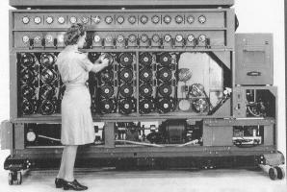
Cracking the Enigma: Cryptanalysis
Poles were running out of resources
Gave copies of their research, bombas, and 2 spare Enigma replicas to the French and British
Led by Turing, the British built a Bombe that did not rely on the message-key repetition but rather on a crib
The United States made an improved version of the British Bombe in 1942
Notes:
Picture: http://www.cryptomuseum.com/crypto/bombe/img/us_bombe_small.jpg

Slide 55
Cracking the Enigma: Cribs
A crib is a ciphertext and a known corresponding plaintext
Ex. Shortly after 6 a.m. each day, the Germans would send out a weather report (“Wetter”)
Exact placement of the plaintext may be unknown
One trick: Enigma is incapable of encrypting a letter as itself (because of the reflector)
Ex.
IPRENLWKMJJSXCPLEJWQ
wetternullsechs

Slide 56
Cracking the Enigma: Enter Alan Turing
Find a crib that leads to loops, similar to Rejewski’s:
w e t t e r
E T J W P X
In rotor setting S: w → E
S+1: e → T
S+3: t → W
3 machines with identical settings, each trying to achieve one of the encipherments (states related as above)
Add electrical wiring to recreate the loop so the light bulb lights up only for the correct settings

Slide 57
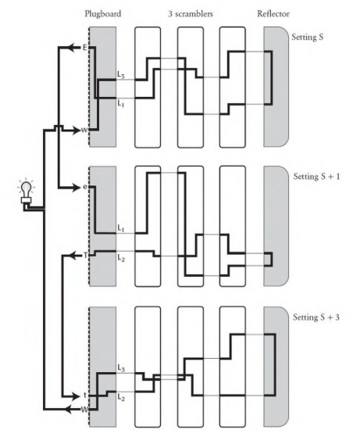

Slide 58
Cracking the Enigma: Enter Alan Turing
Find a crib that leads to loops, similar to Rejewski’s:
w e t t e r
E T J W P X
In rotor setting S: w → E
S+1: e → T
S+3: t → W
3 machines with identical settings, each trying to achieve one of the encipherments (states related as above)
Add electrical wiring to recreate the loop so the light bulb lights up only for the correct settings
Still need to try 5.5 septillion different settings to find the right one for the light bulb!

Slide 59
Cracking the Enigma: Enter Alan Turing
Notice the electrical circuit bypasses the plugboard!
Don’t know the values of L₁, L₂, and L₃: connect all 26 letters with wires
Find the plugboard settings (like Rejewski’s method) after the rotor settings have been established

Slide 60
Cracking the Enigma: Enter Alan Turing
Notice the electrical circuit bypasses the plugboard!
Don’t know the values of L₁, L₂, and L₃: connect all 26 letters with wires
Find the plugboard settings (like Rejewski’s method) after the rotor settings have been established
Bletchley Park allocated £100,000 to the creation of Turing’s new bombes
Each has 12 sets of linked enigma scramblers (for longer loops)
Victory arrived on March 14, 1940
Up to a week to find a key
Improved Agnus Dei arrived on August 8, 1940
Found key within several hours

Slide 61
Cracking the Enigma: Enter Alan Turing
Alan Turing’s comic strips: http://www.turingarchive.org/viewer/?id=147&title=08

Slide 62

Resources/Further Reading
Simon Singh’s The Code Book
The paper Enigma was adapted from this site (http://goo.gl/LBgeD) under the Creative Commons License. Further resources (sample messages, security calculations, setting generators) are available as well.
Android Enigma simulator app
Online Enigma emulator: http://enigmaco.de/enigma/enigma.html
This super cool Instructable on how to make your own full-blown Enigma replica: http://www.instructables.com/id/Make-your-own-Enigma-Replica/

Slide 63
Questions?

Slide 64
References
Crypto Museum. (2018). Bombe: Breaking the Enigma Cipher. Retrieved from http://www.cryptomuseum.com/crypto/bombe/
Hebern, E. (1924). US Patent No. 1510441A: Electric Coding Machine. USA: Google Patents.
Kuhl, A. (2007). Rejewski’s Catalog. Cryptologia, 31(4), pp. 326-331. doi:10.1080/01611190701299487
Lillian Goldman Law Library. (2008). The Avalon Project: The French Yellow Book, Appendix I: Franco-Polish Treaties of 1921 and 1925. Retrieved from http://avalon.law.yale.edu/wwii/ylbka1.asp
Rijmenants, D. (2017). Technical Details of the Enigma Machine. Retrieved from http://users.telenet.be/d.rijmenants/en/enigmatech.htm
Salomon, D. (2012). Data Privacy and Security. New York, NY: Springer Science & Business Media.
Singh, S. (1999). The Code Book. New York, NY: Doubleday.

Slide 65
Backup

Slide 66
Explore
Now let’s try encoding some messages. Assemble your Enigma however you want (write down your settings):
Plaintext: littlecockytables
Let’s compare ciphertexts

Slide 67
Cracking the Enigma: Human Error
Predictable message keys were called cillies
Consecutive keyboard letters (ex. QWE, BNM)
Common keys (ex. girlfriends’ initials)
“Random” scrambler day settings
Avoid putting the same scrambler in the same position the following day
Reduce possible combinations by half for the cryptanalysts!
No adjacent plugboard swaps (ex. S can’t be swapped with R or T)

Slide 68
Cracking the Enigma: Further Complications
Various communication networks with different day-keys: North Africa, Europe, Luftwaffe, Kriegsmarine
Kriegsmarine used a more complicated version of the Enigma:
8 rotors to choose from (instead of 5)
Rotating reflector (instead of fixed)
Non-stereotypical messages (no cribs)
More secure message-key selection and transmission

Slide 69
Cracking the Enigma: Further Complications
Various communication networks with different day-keys: North Africa, Europe, Luftwaffe, Kriegsmarine
Kriegsmarine used a more complicated version of the Enigma:
8 rotors to choose from (instead of 5)
Rotating reflector (instead of fixed)
Non-stereotypical messages (no cribs)
More secure message-key selection and transmission
Germany was gaining the upper hand in the Battle of the Atlantic
Royal Air Force would sow mines to cause the Germans to send warning messages containing the known mine location
“Gardening”: planting mines to get cribs

